Slide 1
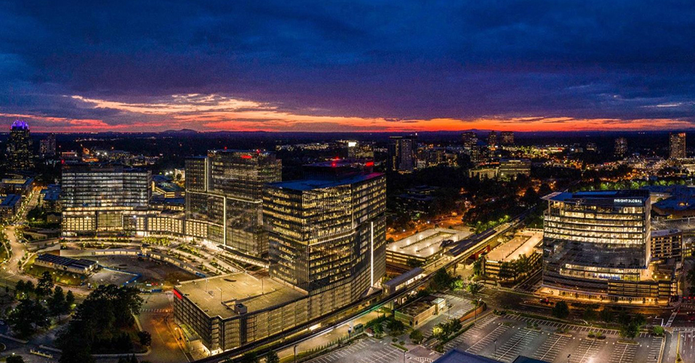
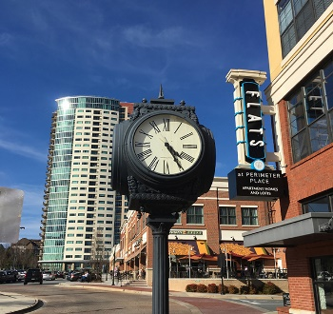
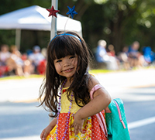
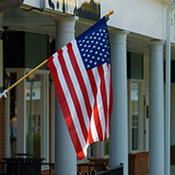

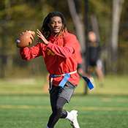

Capital Improvements and Potential G.O. Bond Update
October 1, 2023

Slide 2
Timeline
March 2022 – Out of the annual city council retreat grew an effort for public discussions on the capital needs of the city and ways to pay for them.
April through July 2022 – A series of town halls, council meetings, and committee meetings were held to get public input and hold discussion on the capital needs of the city.
May 2022 – In the end, the city council did not act to put a general obligation bond vote on the 2022 ballot to allow for further planning and analysis.

Slide 3
Timeline
August 2022 – Staff presented city council with a review of the 2022 capital discussion. Out of the effort, grew the Citizen Capital Committee.
September through November 2022 – Citizen Capital Committee met discussing transportation, parks, and trails needs.
March 2023 – City council annual retreat held with the main topic being capital needs.
May 2023 – City Council adopts master trail plan and adopts call for voter referendum on general obligation bonds set for November 2023.

Slide 4
Question
“Shall the City of Dunwoody, Georgia (the “City”) issue general obligation bonds in an aggregate principal amount not to exceed $60,000,000 for the purpose of financing (a) the acquisition, construction, installation, improvement and equipping of (i) parks and recreational areas, (ii) greenspace and (iii) trails, (b) the costs of issuing the bonds and (c) capitalized interest on the bonds? Such approval shall also constitute an approval of the increase in the City’s millage cap of 3.040 only to the extent necessary to repay the bonds.”

Slide 5
Value
Using a $500,000 house with a frozen value of $400,000 as the base example, there would be a 1.049 mill increase needed based on 2023 digest numbers.

Slide 6
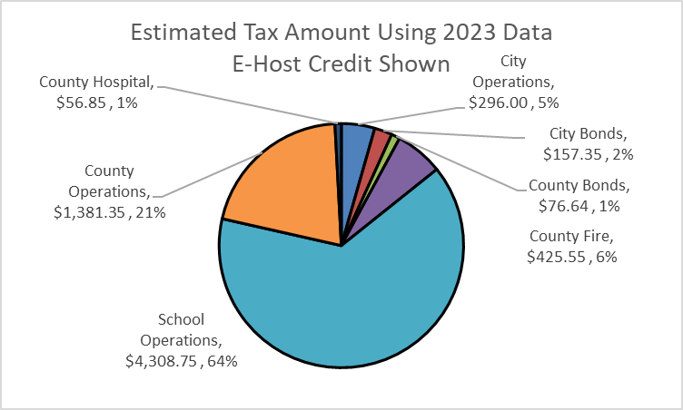
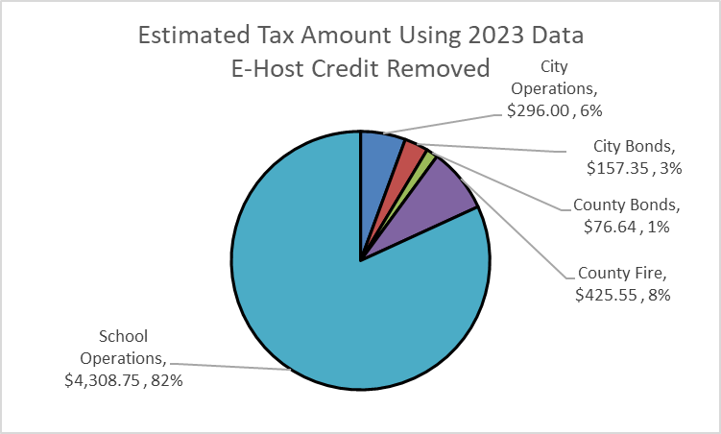
Value
Using a $500,000 house with a frozen value of $400,000 as the base example, there would be a 1.049 mill increase needed based on 2023 digest numbers.

Slide 7
Bonds – Disclaimer
The order of the projects does not indicate their priority. The City may finance the projects in any order. Since the City decided to call a referendum on the issuance of general obligation bonds to finance the projects, Citizens should not assume that the projects will be funded in the order listed or that specific amounts will be spent on any particular project.

Slide 8
Projects
Parks and Greenspace
  Wildcat Park (formerly Roberts Dr Park)
  Homecoming Park (former Vermack Dr Park)
  Softball Fields
  Waterford Park
  Brook Run Park
Trails
  Dunwoody Village
  Winters Chapel Rd
  North Peachtree
  Mount Vernon

Slide 9
Next Steps
June through October 2023 - Various publications of call of election and notice of election.
November 7, 2023 - Election for both potential general obligation bonds and potential SPLOST renewal.
If approved……
November/December – Validation process, creation of Preliminary Offer Statement.
January 2024 – Conversations with rating agencies.
February 2024 – Pricing of bonds.
March 2024 – Closing, funds available.
Note, this timeline for “if approved” is an estimate.

